Slide 1
COMP 4332 / RMBI 4310 Big Data Mining (Spring 2019)
Project 1: Sentiment Classification
TA: Xin Liu (xliucr@connect.ust.hk)

Slide 2
Sentiment Analysis
Generally modeled as classification or regression task
predict a binary or ordinal label

Slide 3
Sentiment Analysis
Simplest task:
Is the attitude of this text positive or negative?
More complex:
Rank the attitude of this text from 1 to 5
(3/5) The room was clean and everything worked fine – even the water pressure
(1/5) …the worst hotel I had ever stayed at ...
Advanced:
Detect the target, source, or complex attitude types

Slide 4
Basic Pipeline
Tokenization: Split document into words (tokens)
Feature Extraction: Find useful features
Classification: Classification via different classifiers

Slide 5
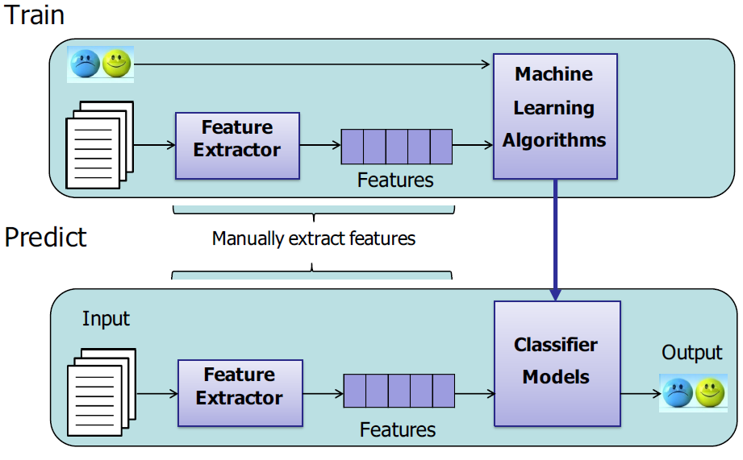
General Pipeline

Slide 6
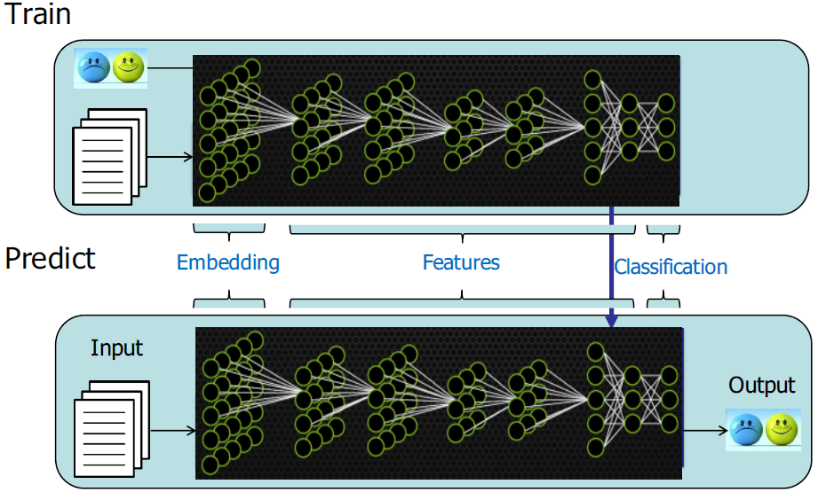
End2end Pipeline

Slide 7
Basic Pipeline
Tokenization: Split document into words (tokens)
Feature Extraction: Find useful features
Classification: Classification via different classifiers

Slide 8
Tokenization
NLTK
tokens = nltk.word_tokenize(text)
spaCy
nlp = spacy.load('en_core_web_sm')
tokens = [t.text for t in nlp(text)]
CoreNLP
https://stanfordnlp.github.io/CoreNLP/other-languages.html#python

Slide 9
Feature Extraction
word frequency or word occurrence
This room is clean.
[0,0,1,1,0,1,0,0,1,0,1]
random projection
In Tutorial 1
word embedding
cbow, skip-gram, GloVe, fasttext
contextualized word representation
ELMo, BERT, GPT, GPT-2

Slide 10
Feature Extraction
user information
nationality
age
date
weekday or weekend
holiday?
hotel rating
Hilton Hotel
Youth Hostel
data mining

Slide 11
Classification
Naïve Bayes
Logistic Regression
Support Vector Machine
Deep Learning

Slide 12
Multi Layer Perceptron
activation
Output
Hidden
Input
In Tutorial 1
Demo: http://playground.tensorflow.org/

Slide 13
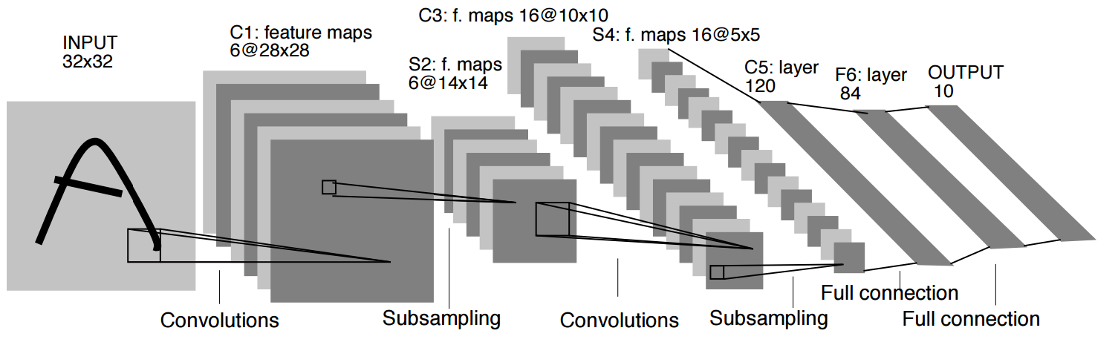
CNN
In Tutorial 2

Slide 14
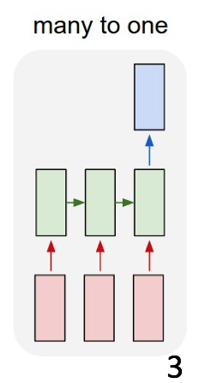
RNN
In Tutorial 3

Slide 15
Dataset
training data: 100000 reviews
validation data: 10000 reviews
test data: 10000 reviews
rating: 1-5
given features: business_id, cool, date, funny, review_id, stars, text, useful, user_id

Slide 16
Evaluation
accuracy on test data

Slide 17
Submission
predictions on test data
report
code
DDL: March 17, 2019
Submission: Each team Leader is required to submit the groupNO.zip file that contains pre.csv, the report, and your team’s code on canvas.
we will check your report with your code and the accuracy.

Slide 18
Grading Rule
Grade | Classifier (80%) | Report (20%) | Remark
50% | example code in tutorials or in Project 1 without any modification | submission
60% | an easy baseline that most students can outperform | algorithm you used | release the accuracy on validation data on March 3
80% | a competitive baseline that about half students can surpass | detailed explanation | release the accuracy on validation data on March 3
90% | a very competitive baseline without any special mechanism | detailed explanation and analysis | release the accuracy on validation data on March 10
100% | a very competitive baseline with at least one mechanism | excellent ideas | release the accuracy on validation data on March 10

Slide 19
Thank You

